Slide 1

RITM1295263 / ACBSD-4524 BiggyAI Final Solution Design
Architect: Mohamed Kerbachi
02/03/2026
Internal

Slide 2
Version Control
Version | Date | Author | Description
01.00 | 02/03/2026 | Mohamed Kerbachi | Solution Design - Final

Slide 3
Background and Objective
Background, Objectives & Solution Summary
Background and objectives overview:​
GTS Neptune Team uses BigPanda for IT incident management and launched a POC for BiggyAI, its GenAI-powered service. The goal: validate BiggyAI’s ability to improve ServiceNow workflows by integrating data from ServiceNow, and Teams MIM channels.​
​
Transition to future state:​
BiggyAI can be integrated into production and complies with all approved security patterns, including SSO via EntraID, OAuth 2.0, and IP whitelisting. Real-time ServiceNow connectivity has been implemented through an API Gateway in Aegon’s AWS tenant. Neptune integration remains planned for a future phase.
Executive Sponsor ​
Stefan Simenon​
​
Initiative Sponsor​
Jeremy Kulbartz​ / Tony Penticoff
​
Business Unit Sponsor​
ET

Slide 4
Business Case
Impacted Business Units
Problem statement:
The growing volume and complexity of incidents in ServiceNow.
The need for faster, more intelligent incident resolution.
The strategic initiative to adopt AI and automation across IT operations.
Promise of Value:
The POC demonstrated that Biggy AI significantly reduced manual effort, accelerated response times, and improved the accuracy of incident triaging and resolution. These improvements led to better service quality, higher user satisfaction, and enabled more proactive IT operations.
The following Country/Business Unit(s) will be impacted by this Solution Design:
☐ | TA | ☐ | Spain
☐ | UK | ☐ | HR Global
☐ | NL | ☐ | ASIA/TLB
☐ | AAM | ☐ | Corporate Centre
X | GTS / Corporate tech | ☐ | Other (Specify) _________________
☐ |  | X | Global
Enterprise Architecture Classification
X | Core: Technology components that are shared by all BUs across the enterprise​
☐ | Common: Technology components shared by multiple business units within the enterprise
☐ | Distinct: Technology components that are specific to a particular business unit within the enterprise​

Slide 5

Business Case and Roadmap
Problem statement:
The growing volume and complexity of incidents in ServiceNow.
The need for faster, more intelligent incident resolution.
The strategic initiative to adopt AI and automation across IT operations.
Promise of Value:
The POC demonstrated that Biggy AI significantly reduced manual effort, accelerated response times, and improved the accuracy of incident triaging and resolution. These improvements led to better service quality, higher user satisfaction, and enabled more proactive IT operations.
Solution Design Timeline:
POC November-December 2025
POC findings presented at ARB 8th January 2026
Solution Design presented at ARB 8th January 2026
Deployment schedule:
Deployed in DEV environment
Deployed in MODEL environment
To be deployed in PRODUCTION after final ARB approval
Impacted Business Units
The following Country/Business Unit(s) will be impacted by this Solution Design:
☐ | TA | ☐ | Spain
☐ | UK | ☐ | HR Global
☐ | NL | ☐ | ASIA/TLB
☐ | AAM | ☐ | Corporate Centre
X | GTS / Corporate tech | ☐ | Other (Specify) _________________
☐ |  | X | Global
Enterprise Architecture Classification
X | Core: Technology components that are shared by all BUs across the enterprise​
☐ | Common: Technology components shared by multiple business units within the enterprise
☐ | Distinct: Technology components that are specific to a particular business unit within the enterprise​

Slide 6
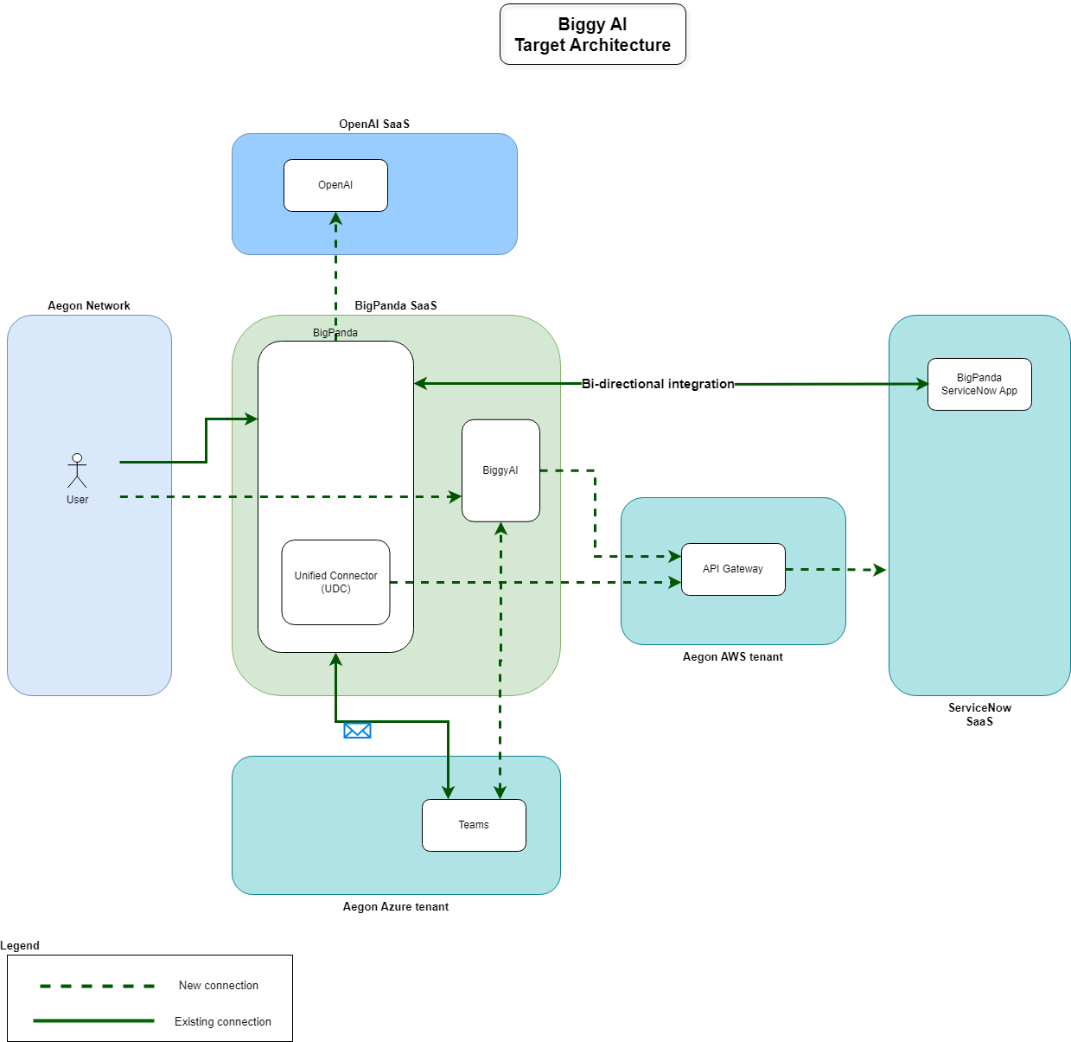
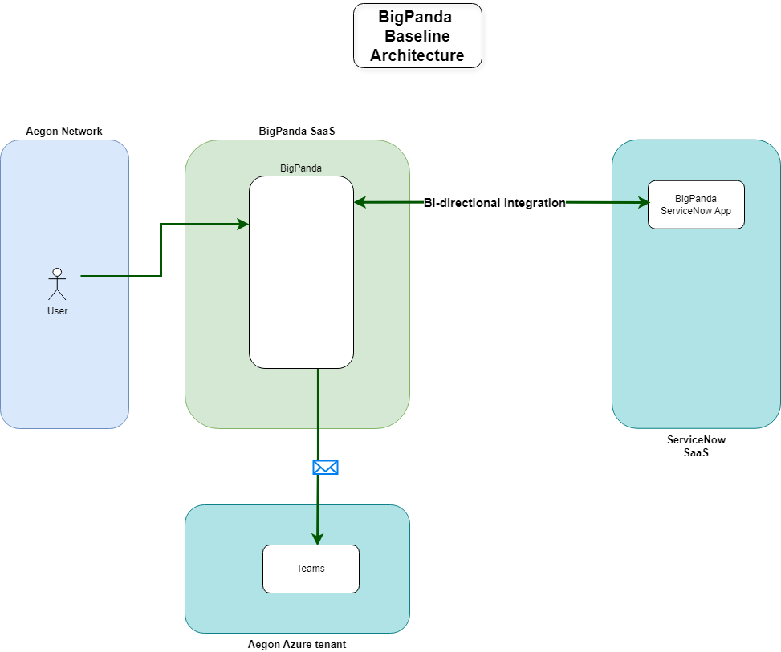
Baseline Technology Architecture
Target Technology Architecture

Slide 7
Design update from last ARB
List of Tables that BiggyAI will be able to access
incident
change_request
problem
kb_knowledge
cmdb_ci
task_ci
change_task
problem_task
sys_user
u_kb_template_how_to_it
sys_user_group
List of API Endpoints that BiggyAI will be able to interact (with {table} in the below list is represented by the list of tables above)
GET /api/now/table/{table}
GET /api/now/table/{table}/{sys_id}
GET /api/now/on_call_rota/oncallgroups
GET /api/now/stats/{table}
GET /api/now/ui/meta/{table}
GET /api/now/doc/table/schema
Notes:
Summary of the key business requirements for the solution

Slide 8
Training
The main issue found during the POC were related to users’ lack of familiarity with interacting with biggyAI.
To enhance service efficiency trainings and certifications were scheduled by BigPanda team for key teams:
DSC (Distributed Service Center)​
Command Center​
Change Managers​
Major Incident Managers​
TA L2 Support Teams (x2) (were not involved in the POC)
Notes:
Summary of the key business requirements for the solution

Slide 9
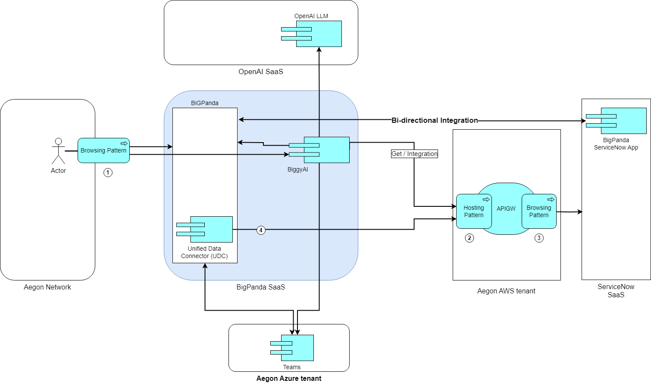
Integration Architecture
Components/Patterns Used |  | Link
1 | Browsing Pattern | GTS APIGW - Project Solution Design Document.docx
2 | Hosting Pattern | GTS APIGW - Project Solution Design Document.docx
3 | Browsing Pattern | GTS APIGW - Project Solution Design Document.docx

Slide 10
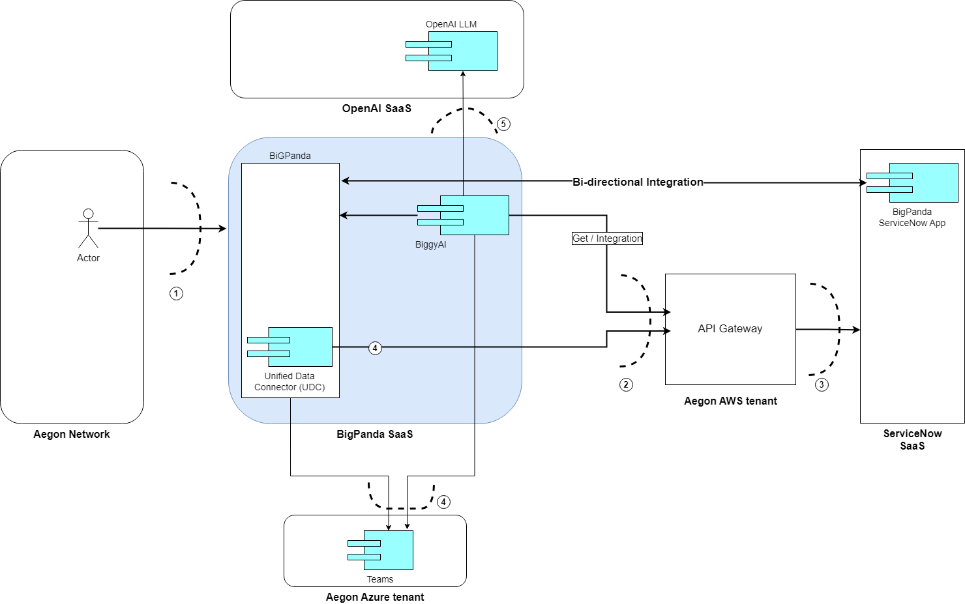
Security Boundaries
Security Boundary Reference | Existing Pattern? | Description
1 | Browsing Pattern | Corporate Firewall.
2 | Hosting Pattern | Corporate Firewall + LB. APIs calls accepted only from whitelisted BigPanda’s IPs.
3 | Browsing Pattern | Corporate Firewall.
4 |  | Access to Teams in Aegon’s Azure tenant, authentication with EntraID
5 |  | BiggyAI access to LLMs hosted in BigPanda Azure tenant. All connectivity and management of this integration are handled exclusively by BigPanda.

Slide 11
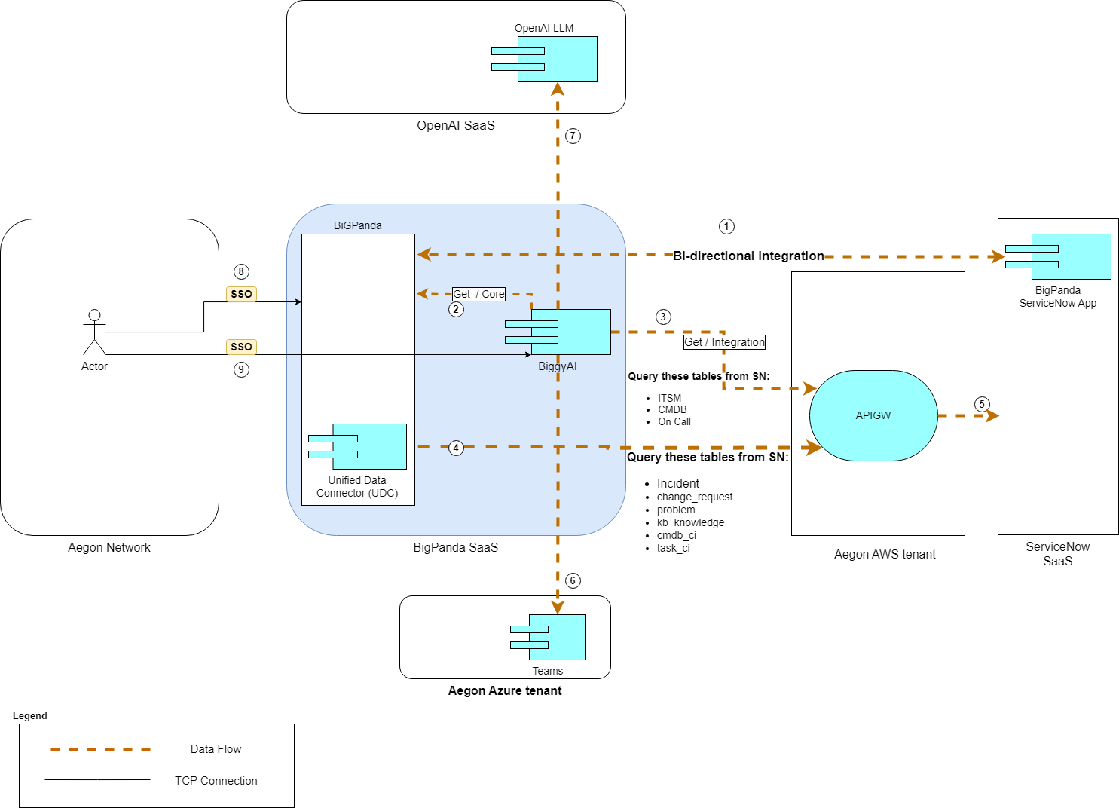
Data Flow
Data Privacy Impact Assessment:​
DPIA #12351
Data Classification
Data Classification |  | Data Legal and Regulatory Classification
☐ | Strictly Confidential | ☐ | Financial Information
☐ | Confidential | X | Personal Identifiable Information
X | Internal | ☐ | Protected Health Information
☐ | Public | ☐ | Payment Card Information
☐ | No Data Shared | ☐ | No Personal Data Shared
Data Flow Reference |  | Description
1 | BigPanda connection to ServiceNiw | Existing connection from BigPanda to ServiceNow (RITM0051519-ACBSD-2049- BigPanda Event Management Solution.docx).
2 | Biggy AI query to BigPanda | Internal connection to BigPanda network.
3 | BiggyAI query ServiceNow | BiggyAI queries to ServiceNow for data that has not been received yet after a user question. Get API call using Oauth v2 through Aegon’s API gateway / SSL encryption
4 | BiggyAI query ServiceNow | BigPanda Unified Data Connector (UDC) trickle queries to ServiceNow Get API call using Oauth v2 through Aegon’s API gateway / SSL encryption

Slide 12
Technology Components & Architecture Impacts
Technology Risk Assessment:
26-BigPanda GenAI Biggy service -Production
Technology Component Type​ | Technology Component Name​ | CMDB ID​ | Architecture Impact​ | Tech Lifecycle Strategy ​ | Risk Rating​
Business Application​ | ServiceNow​ | CI002457504​ | Reuse​ | Buy​ | High​
​ | Neptune​ | CI017529562 ​ | Reuse​ ​ | Buy​ | High ​
COTS | API Gateway (GTS SAAS-PAAS TO SAAS-PAAS API GATEWAY) | APM0004873 | Reuse | Buy | Critical
SaaS​ | Teams​ | CI018550166​ | Reuse​ ​ | Buy​ | Low​
SaaS​ | BiggyAI (BIGPANDA AI INCIDENT ASSISTANT)​ | APM0006366​ | New​ | Buy​ | Low​

Slide 13
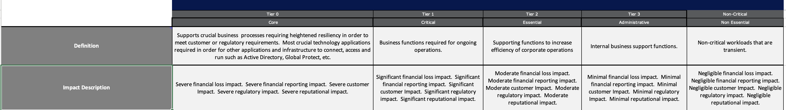
Operational Resiliency Targets
The solution is designed for the following GTS resiliency target level:
The BiggyAI application should be classified as Tier 2, as it helps the operations team in reducing diagnostic time and generating incident reports. While its unavailability would decrease efficiency, teams can continue to operate without it.

Slide 14
Waivers and/or Exceptions
Architecture Alignment to Standards Score: 96%
Risk Acceptances
# | Acceptance Title | Exception Description | Link to Risk Exception Acceptance
1
2
3
4
5
6
7
No Waiver
No Exception
Risk Remediations
# | Remediation Title | Exception Description | Link to Risk Remediation Acceptance
1
2
3
4
5
6
7
Notes Regarding Exceptions to Standards or Additional Concerns
Prior to an item being added to the ARB agenda for Solution Design – Final ARB, approval for risk acceptance or risk remediation must be obtained, not merely logged. Technology owner for the initiative is responsible for obtaining risk acceptance or risk mediation approvals.

Slide 15

Questions?

Slide 16
End of presentation

